Slide 1
WORKFLOW Automation
Automate tasks with workflow

Slide 2
Proposal
When building or deploying a network, often requires to follow a sequence of tasks
These tasks can include steps that require to be repetitive
Need a system that would orchestrate and track the status over a period of time

Slide 3
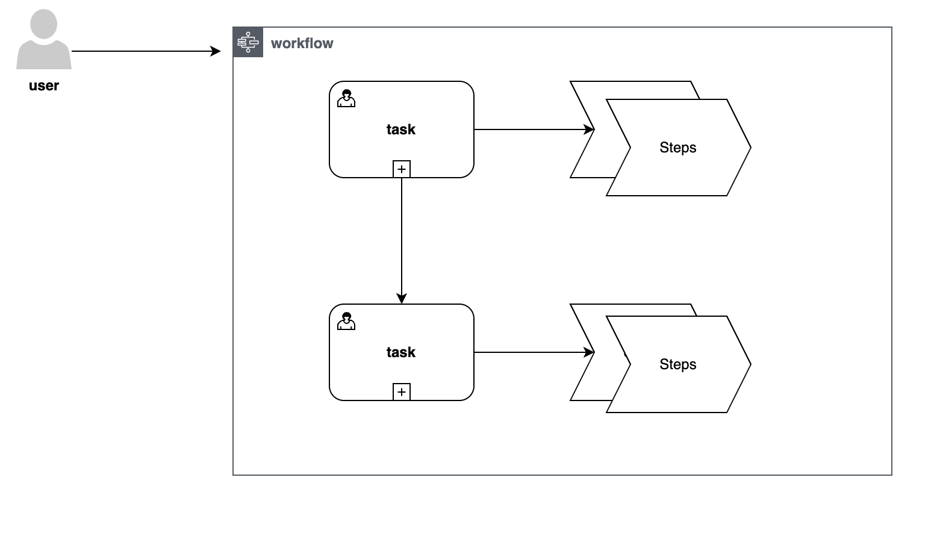
WORKFLOW/TASK/Steps API
User can create multiple unique workflows
A workflow can be like deploy a rack on a site that would allow to have services connected
Tasks can be to order material, build a design plan, prepare the network for connecting new site
Steps can be to reserve the ip addresses, validate the racks or push the configs

Slide 4
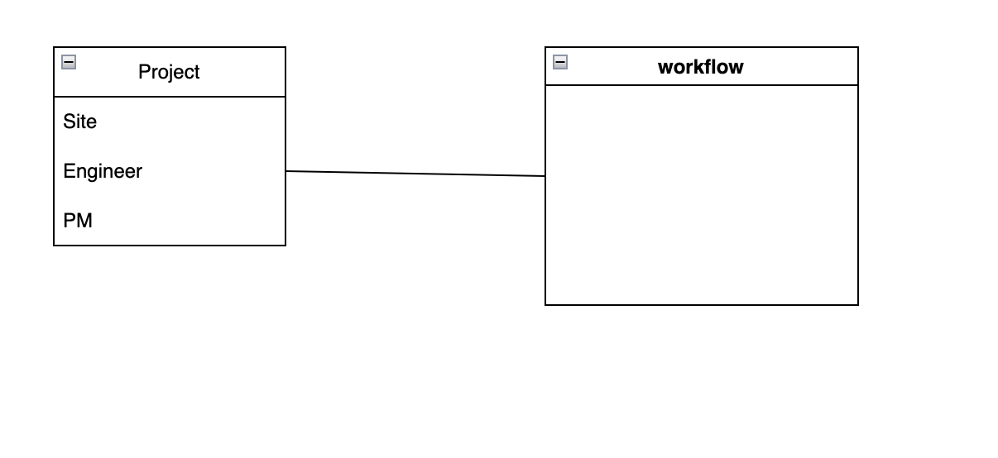
Project API
A user should be able to create multiple projects with same workflow

Slide 5
STEPs Automation
Each Step can be a manual action with instructions or should be able to call other systems to trigger the auto completion

Slide 6
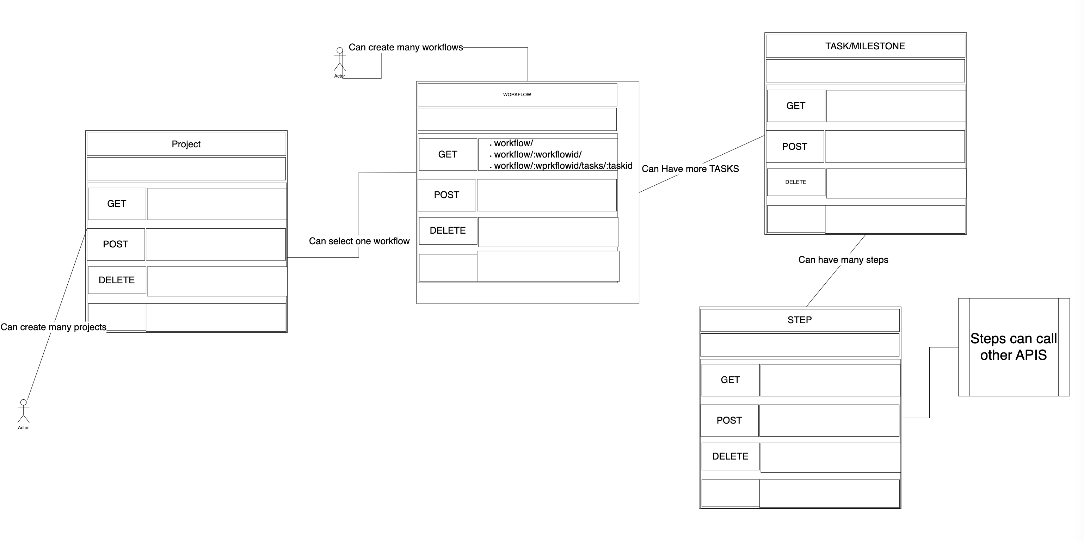
Required API’s

Slide 7
What are key learnings from course
Staring with test cases and going back to implement the code is an art ☺
often starting with a test case but ends up writing code that doesn’t cover the test
Picking up the right tools at the beginning of the project proposal
Often doing google gives different packages , picking up the correct one requires deepdive of features that are expecting
Example picking up formik for latest version which is not supported

Slide 8
What need to be implemented
Security to allow users to login and access routes
Robust test cases
Integration with other systems as needed

